Slide 1
Day 6: JOINS (INNER, LEFT, RIGHT, FULL)
Inner Join
Left Join
Right Join
Self Join
Full outer Join
Cross Join
Union-Union All

Slide 2
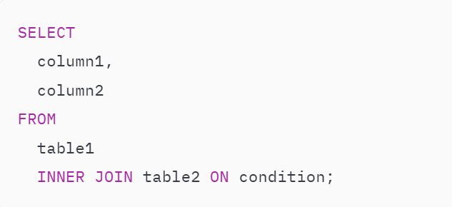
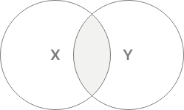
INNER JOIN clause
Allows you to merge rows from two related tables.
Typically, the condition compares values between two columns of the two tables for equality:

Slide 3
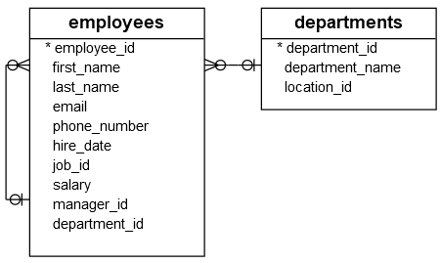

Slide 4
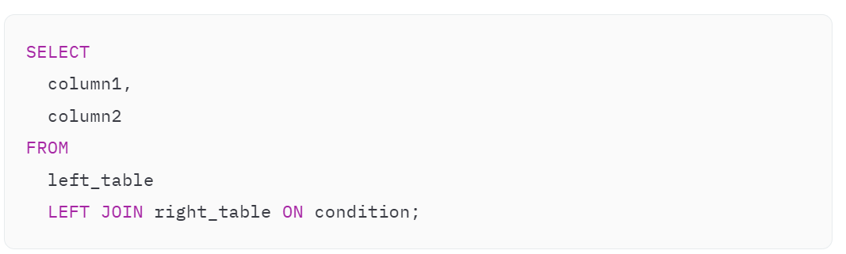
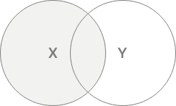
LEFT JOIN clause
always includes all rows from the left table.
LEFT JOIN clause matches every row from the left table (left_table) with every row from the right table (right_table) based on the condition.
The LEFT JOIN and LEFT OUTER JOIN are the same because the OUTER keyword is optional.

Slide 5
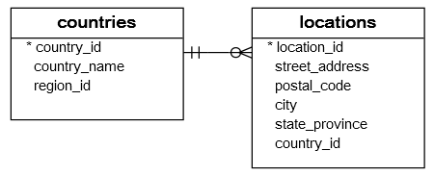

Slide 6
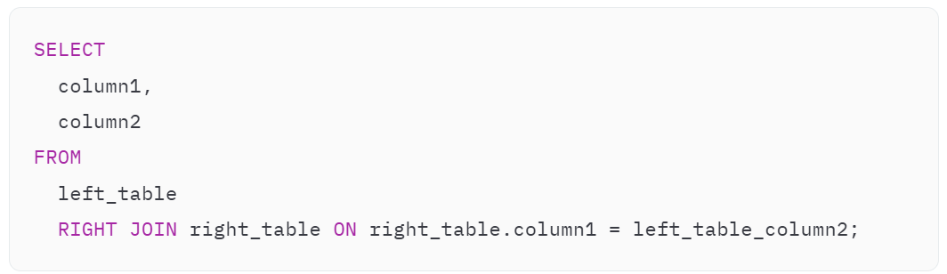
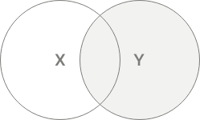
RIGHT JOIN clause
always includes rows from the right table.
RIGHT JOIN checks the condition with each row in the left_table. If the condition is true, the RIGHT JOIN merges two rows from both tables into a single row.
RIGHT JOIN and RIGHT OUTER JOIN are the same

Slide 8
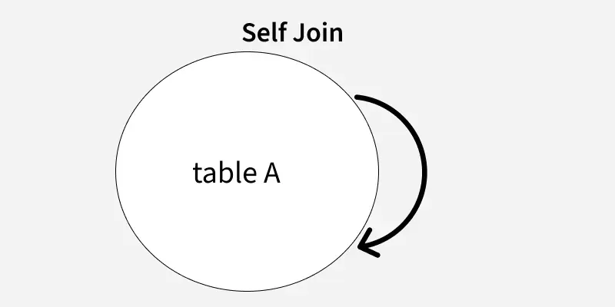
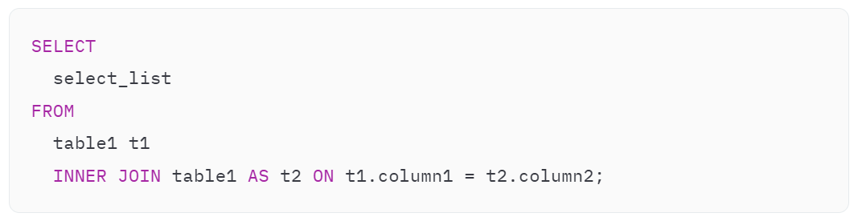
self-join
You can use a join to compare rows within the same table. In this case, you join a table to itself that forms a self-join.
It uses table aliases to treat the same table as separate tables within the same query.

Slide 9
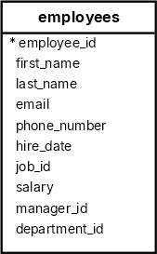

Slide 10
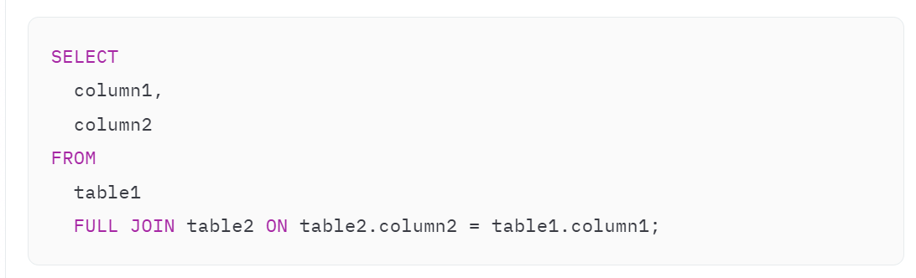
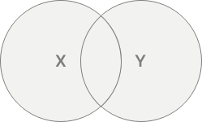
FULL OUTER JOIN clause
clause combines rows from both tables into a single row and includes it in the result set.
a FULL OUTER JOIN is a combination of a LEFT JOIN and a RIGHT JOIN
The OUTER keyword is optional, you can omit it in the query.

Slide 11
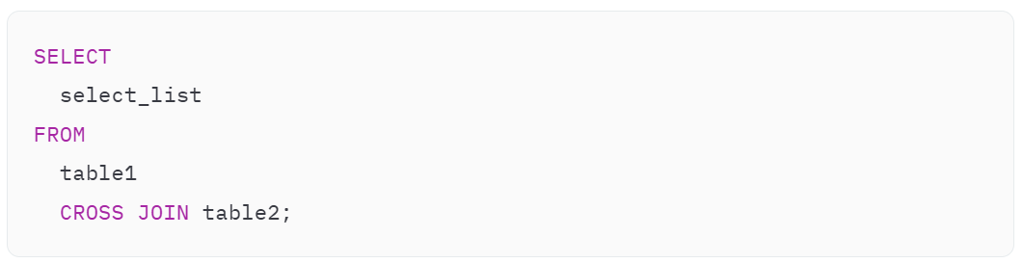
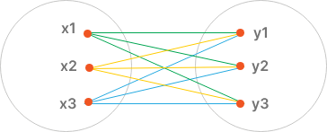
CROSS JOIN clause
allows you to create combinations of all rows from two tables.
The result set of a CROSS JOIN is often called the Cartesian product of two tables.
If the table1 has n rows and table2 has m rows, the CROSS JOIN will return a result set that includes n * m rows.

Slide 12
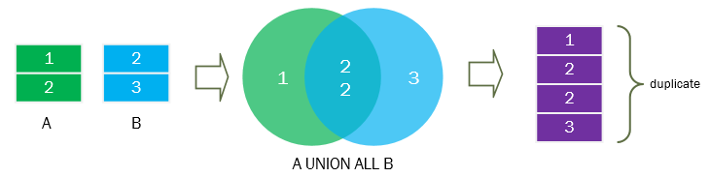
Union –Union All
To combine the result sets of two SELECT statements into a single result set.
Same number of columns: The SELECT statements must have the same number of columns.
Compatible data types: The corresponding columns in each SELECT statement must have compatible data types.
Column names: The column names of the second query will determine the column names of the final result set.
Execution order: The UNION operator executes the SELECT statements independently and combine the result sets.
Sorting result set: Use the ORDER BY clause in the second query to sort the rows in the final result set.

Slide 13
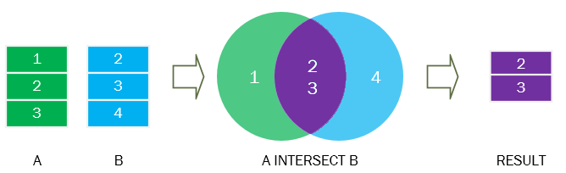
SQL INTERSECT operator
To finds the common rows of the result sets of two SELECT statements.
Same number of columns: the two SELECT statements must have the same number of columns.
Compatible data types: The corresponding columns in the SELECT statements must have compatible types.
Column names: The column names of the second query will decide the column names of the final result set.
Sorting rows: to sort the rows in the final result set, you use an ORDER BY clause in the second query.
Query execution: The INTERSECT statement executes each SELECT statement independently and finds the common rows.

Slide 14
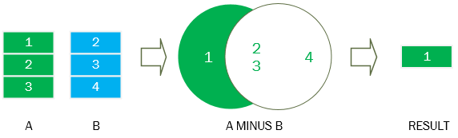
SQL MINUS(EXCEPT) operator
To find the difference between two result sets of two SELECT statements
Same number of columns: The SELECT statements must have the same number of columns.
Compatible data types: The corresponding columns in the SELECT statements must have compatible data types.
Column names: The column names of the result set of the second SELECT statement determines the column names of the final result set.
Order of execution: The MINUS operator execute each SELECT statement independently and then return the difference.
Sorting rows in final result set: To sort the final result set, you place an ORDER BY clause in the second SELECT statement.

